Slide 1

DIVOC Idea Pitch Presentation
By Brandin Bulicki & Harsh Sharma
DIVOC
1

Slide 2
How do you feel about COVID-19?
2
Notes:
How do you feel about COVID-19?
Based on a study conducted by Mental Health America, when COVID-19 emerged as a clear and present public health threat, most people felt the same range of emotions. Maybe you feel bored, lonely, or even irritated at times.

Slide 3
So? Mission Statement…
With the Disaster avoidance Initiative through Virtual Objective Communication (DIVOC) app, those affected from the pandemic will be able to maintain a sense of normalcy in these uncertain times.
3

Slide 4
Design Process and Participant Choice
DIVOC
Created an abstract design process that would sustain for the design requirement analysis phase and the user study phase.
Devised protocols to ensure uniformity across conducted processes.
Participants of various backgrounds: still restricted to U.S.
Consisted of healthcare experts and general public
Offered different perspectives on the issue
Different age groups: offering simplicity
Pre-evaluation study prior to remote testing
4

Slide 5
Design Process: User Needs
DIVOC
Gain a positive mindset during the unprecedented time.
Difficulties included:
Finding reliable and all-across consistent information.
Communicating with others.
Finding trustworthy information.
Finding gigs/small jobs to sustain.
Resources to maintain healthy lifestyle.
Interactions with healthcare experts for advice.
Resources for thriving upon hobbies and leisure.
5
Notes:
From the point of the first conducted study to understand user needs, it was evident that interviewing healthcare experts and general public yielded in multiple different desired functionalities. Hence, since the app was supposed to be built around the general public’s needs, we filtered out important attributes that were in consensus and had to be addressed. This allowed us to prioritize requirements and arrive at a defined MVP that would not go beyond to a scope creep.

Slide 6
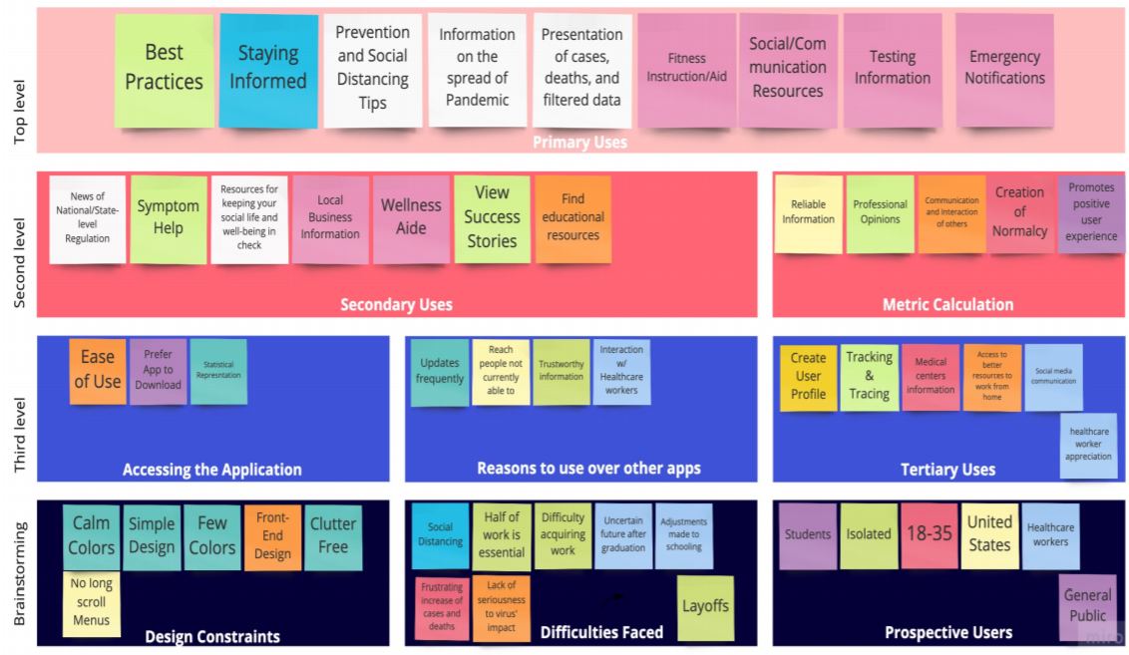
Design Process: Affinity Diagram
DIVOC
6

Slide 7
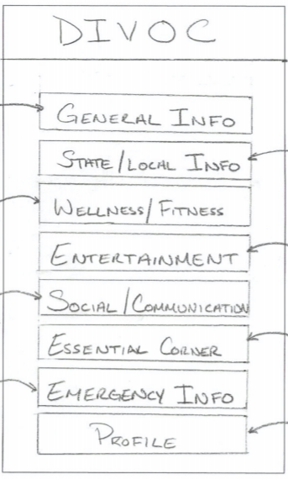
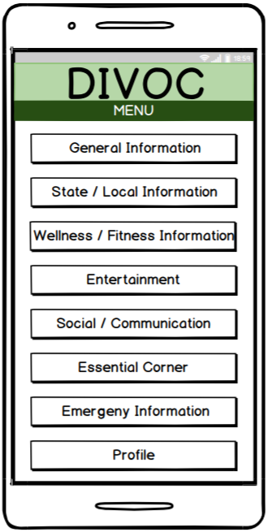
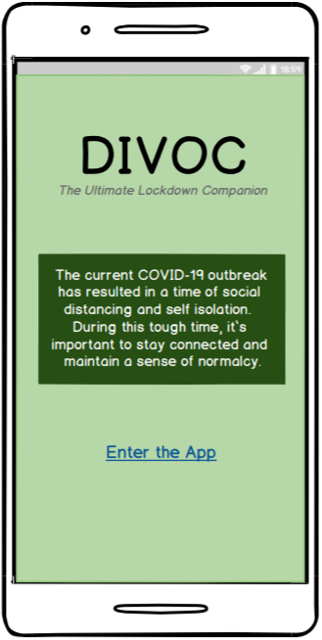
DIVOC
Design Process: Prototyping
Low-Fidelity
High-Fidelity
Revised
7
Notes:
Whilst creating a prototype, to ensure that the design was meeting the needs of our users, the team first sketched a low-fidelity prototype.
Low-fidelity annotations allowed for a greater understanding of interactions.
Using Balsamic, a high-fidelity, semi-functioning prototype was created. This was presented to the class and received feedback. The feedback, in turn, allowed us to adjust the designs as part of the rapid prototyping cycle.

Slide 8
Design Process: User Testing
To gain a better understanding of whether the design requirements from our initial research were met in the DIVOC prototype, user testing was conducted.
Based upon similar protocols carried out during research phase.
Consisted online and remote testing to build upon each other for further feedback acquisition.
Online testing was conducted via usertesting.com. Three participants selected at random were chosen to review the DIVOC prototype. Each participant reviewed the application following the tasks set forth. Responses were vocalized and their interactions were recorded in a screen recording of their session.
Face-to-face testing was conducted via video calls. Three participants were chosen to review the DIVOC prototype. Again, each participant reviewed the application following the tasks set forth.
8
Notes:
Combination of new users and users that took part in previous research study proved to clarify different UX patterns. Helped us to come up with useful information to put on dashboard page.

Slide 9
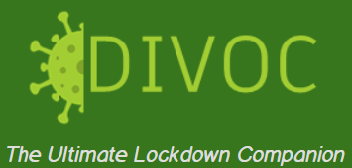
Final Design
DIVOC
9
Notes:
Open up Final Prototype

Slide 10
Final Design: Analysis of Design
DIVOC
Visibility
Users options are clearly depicted and are easy to use.
Feedback
Every action has a reaction (ie. notification of success when signing up for alerts)
Affordance
Clear relationship of what something looks like and how it is used (ie. chatroom tabs)
Mapping
The controls to something closely resemble the effect. (ie. the controls to send a message)
Constraints
Limits to an interaction. (ie. navigating from one screen to another through the menu screen)
Consistency
The same action causes the same reaction every time. (ie. using the menu button)
10

Slide 11
Final Design: Design Improvements
DIVOC
Adjusted the titles of any misinterpreted labels.
Reworked the landing page to ensure that the user can understand what the application is used for prior to delving into it for themselves.
Added the menu/back button to make its use more noticeable.
Determined if there are any elements that can be added to any one screen.
Determined whether there is a more preferred way to display the data.
Discussed the design elements currently used and analyze the feedback received. Determined if there is a better way to present the application. Reformatted accordingly.
11
Notes:
As pointed out in the prototype demonstration, naming conventions were adjusted to better suit the description of the app and its contents. Additionally, it was prevalent from the user testing that functional features such as back buttons, various colors, and visual representations were missing. These were accordingly added.

Slide 12
References
DIVOC
Apple. “‎Apple COVID-19.” App Store, 26 Mar. 2020, apps.apple.com/us/app/id1504132184.
ArcGIS Dashboards, gisanddata.maps.arcgis.com/apps/opsdashboard/index.html#/bda7594740fd40299423467b48e9ecf6.
Brandom, Russell. “Answering the 12 Biggest Question About Apple and Google's New Coronavirus Tracking Project.” Theverge.com, 11 Apr. 2020, www.theverge.com/2020/4/10/21216484/google-apple-coronavirus-contract-tracing-bluetooth-location-tracking-data-app.
“Contact Tracing Bluetooth Specification.PDF,” 11 Apr. 2020.
“Coronavirus Resource Center.” Johns Hopkins Coronavirus Resource Center, 2020, coronavirus.jhu.edu/.
“COVID-19.” Apple Inc, www.apple.com/covid19/.
“Overview of COVID 19 Contact Tracing Using BLE.PDF” 10 Apr. 2020.

